Slide 1



Hydrogen is at a ‘tipping point’ with $11 trillion market set to explode (Bank of America)
PUBLISHED SUN, SEP 27, 2020 cnbc.com
After decades of false starts, hydrogen technology is poised to take off as falling production costs, technological improvements, and a global push toward sustainability converge. The firm believes this will generate $2.5 trillion in direct revenue — or $4 trillion if revenue from associated products such as fuel cell vehicles is counted — with the total market potential reaching $11 trillion by 2050.
“Hydrogen … could supply our energy needs, fuel our cars, heat our homes, and help to fight climate change,” the firm said in a recent note to clients. “We believe we are reaching the point of harnessing the element that comprises 90% of the universe, effectively and economically.”
The technology hasn’t taken off to date for a variety of reasons, including that hydrogen is expensive to manufacture since it has to be produced using another energy source, as well as because it’s less energy efficient than fossil fuels.
Bank of America compared the sector to smartphones pre-2007 or the internet pre-dot.com, saying now is the time to look at it, “before it goes mainstream.” Among the sectors that stand to benefit are industrials, infrastructure and renewables.
© LERG 2020. All rights reserved.

Slide 2
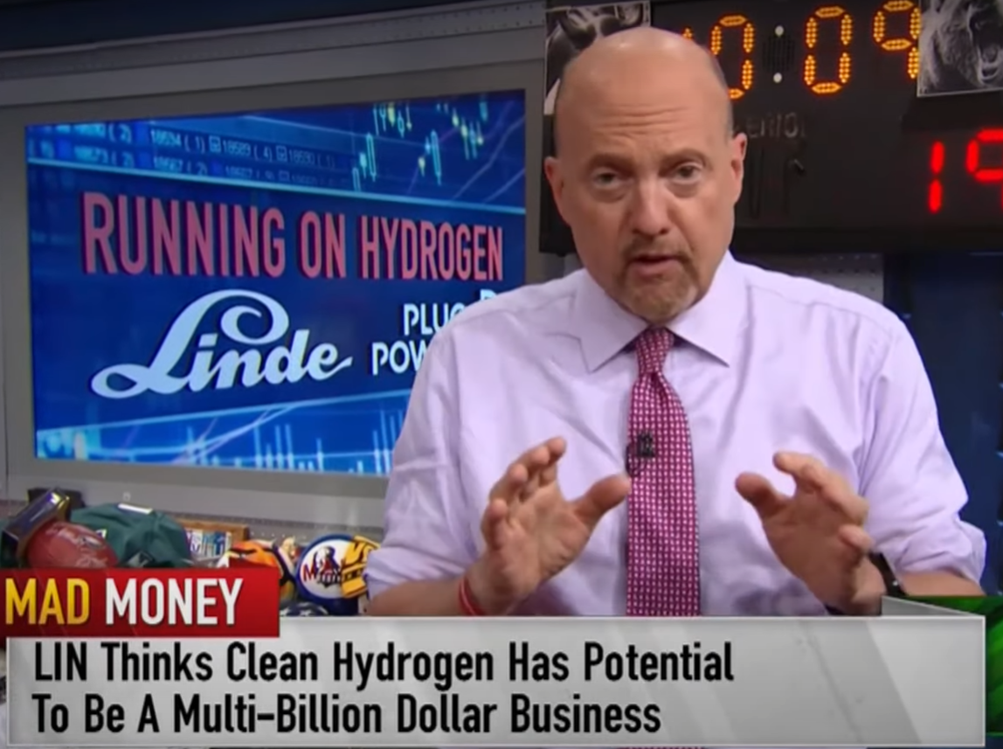
Jim Cramer on Mad Money
October 9, 2020
“If just 1% of the heavy long-haul trucking moves to hydrogen powered vehicles, that would create a $20 billion annual market for hydrogen…”
“With governments around the world getting more aggressive about fighting climate change, I’m pretty confident it’s going to happen…”
© LERG 2020. All rights reserved.

